Slide 1

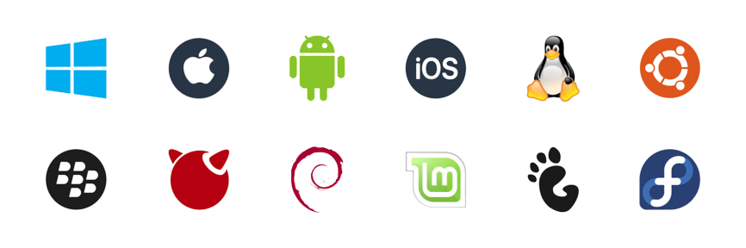

Operating system
- By nishchal acharya

Slide 2

Introduction to operating system
An operating system is a piece of software that manages files, manages memory, manages processes, handles input and output, and controls peripheral devices like disk drives and printers, among other things.
Also it is an system software that manages computer hardware and software resources, and provides common services for computer programs.
Some example of operating system are Android OS, macOS, Linux, Ubuntu, windows.

Slide 3


Why operating system used
Operating System is used as a communication channel between the Computer hardware and the user. It works as an intermediate between System Hardware and End-User. Operating System handles the following responsibilities:
It controls all the computer resources.
It provides valuable services to user programs.
It coordinates the execution of user programs.
It provides an interface (virtual machine) to the user.

Slide 4

Function of operating system
Memory Management
The operating system manages the Primary Memory or Main Memory. Main memory is made up of a large array of bytes or words where each byte or word is assigned a certain address. Main memory is fast storage and it can be accessed directly by the CPU. For a program to be executed, it should be first loaded in the main memory.
An Operating System performs the following activities for Memory Management:
It keeps track of primary memory, i.e., which bytes of memory are used by which user program. The memory addresses that have already been allocated and the memory addresses of the memory that has not yet been used.
In multiprogramming, the OS decides the order in which processes are granted memory access, and for how long.
It Allocates the memory to a process when the process requests it and deallocates the memory when the process has terminated or is performing an I/O operation.

Slide 5

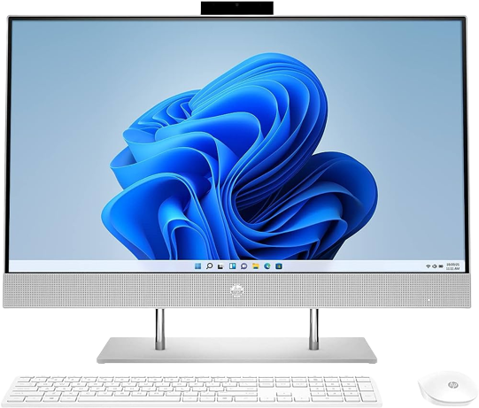
Specification of my computer
Desktop name: DESKTOP-L1OVAG8
Processor: Intel(R) Core(TM) i5-4690T CPU @ 2.50GHz 2.50 GHz
Installed RAM: 14.0 GB
Device ID: 11146AD1-31B8-4852-81EC-9F8845527429
Product ID: 00331-10000-00001-AA709
System type: 64-bit operating system, x64-based processor
OPERATING SYSTEM Windows 10

Slide 6

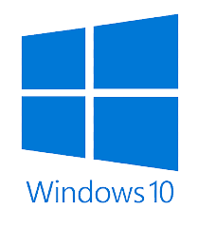

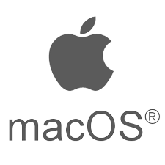
Top 3 OPERAtiong system
Windows: Microsoft Windows is a group of several proprietary graphical operating system families developed and marketed by Microsoft.
Linux: Linux is a family of open-source Unix-like operating systems based on the Linux kernel.
macOS: macOS previously OS X and originally Mac OS X) is a Unix operating system developed and marketed by Apple Inc. since 2001.
Windows 10
Linux
macOs

Slide 7

Thankyou So much for this opportunity
- By Nishchal Acharya

